Slide 1
Consensus Algorithms
Consensus is the process that allows all processes in a network to agree on some specific value in the presence of faults.
Distributed systems are classified into two main categories:
Message passing
Shared memory.
In the context of blockchain, we are concerned with the message-passing type of distributed systems, where participants on the network communicate with each other via passing messages to each other.
The consensus problem can also be classified based on these two paradigms.
For example, Bitcoin is a public blockchain. It runs PoW, also called Nakamoto consensus. In contrast, many permissioned blockchains tend to run variants of traditional or classical distributed consensus.

Slide 2
Fault tolerance
A fundamental requirement in a consensus mechanism is fault tolerance in a network, and it should continue to work even in the presence of faults. This naturally means that there must be some limit to the number of faults a network can handle since no network can operate correctly if many of its nodes fail. Based on the fault-tolerance requirement, consensus algorithms are also called fault-tolerant algorithms, and there are two types of fault-tolerant algorithms:
Crash fault-tolerance (CFT), which covers only crash faults or, in other words, benign faults.
Byzantine fault-tolerance (BFT), which deals with the type of faults that are arbitrary and can even be malicious.
In the case of CFT, at least 2f + 1 number of nodes is required to achieve consensus.
In the case of BFT, at least 3f + 1 number of nodes is required to achieve consensus.
where f represents the number of failed nodes.

Slide 3
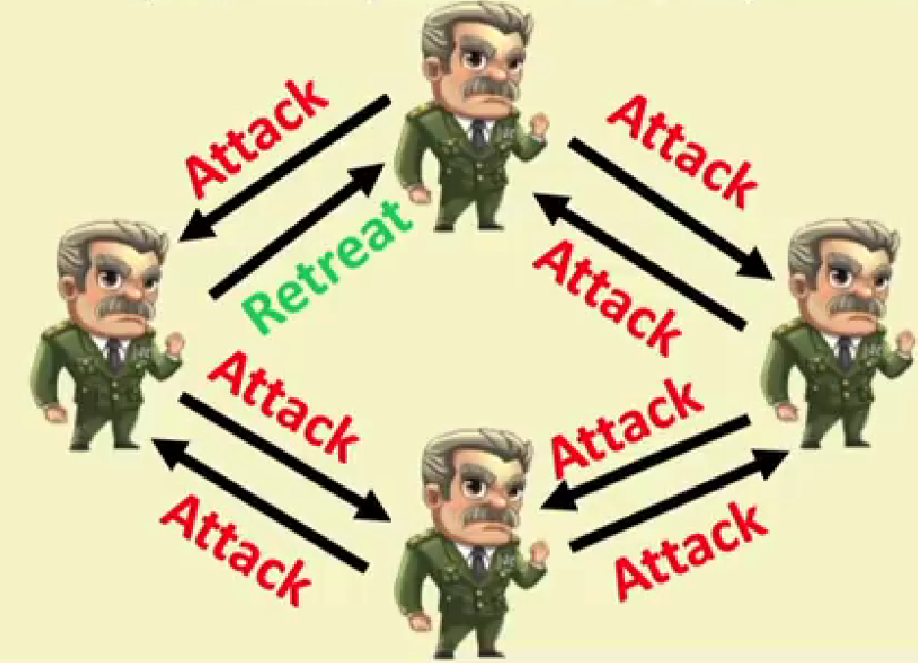
Fault Tolerance: The Byzantine Army Problem
Byzantine army are encamped around a city they plan to attack. The generals must decide whether to attack or retreat. They face two key challenges:
Coordination: All generals must agree on the same decision (attack or retreat). A lack of consensus could result in a disastrous defeat.
Traitors: Some generals may be traitors and send conflicting or false messages to disrupt the decision-making process.

Slide 4
Classification of Consensus Algorithms
The consensus algorithms can be classified into two broad categories:
Traditional: Voting-based consensus. Traditional voting-based consensus has been researched in distributed systems for many decades. Many fundamental results and a lot of ground-breaking work have already been produced in this space. Algorithms like Paxos and PBFT are prime examples of such types of algorithms. Traditional consensus can also be called fault-tolerant distributed consensus.
Lottery-based: Nakamoto and post-Nakamoto consensus. Lottery-based or Nakamoto-type consensus was first introduced with Bitcoin. This class can also be simply called blockchain consensus.

Slide 5
Requirements for Consensus Algorithms
The fundamental requirements of consensus algorithms boil down to Safety and Liveness conditions.
The Safety requirement generally means that nothing bad happens, and is usually based on some safety requirements of the algorithms, such as agreement, validity, and integrity.
  Agreement: The agreement property requires that no two processes decide on different values.
  Validity: Validity states that if a process has decided on a value, that value must have been proposed by a process. In other words, the decided value is always proposed by an honest process and has not been created out of thin air.
  Integrity: A process must decide only once.
The Liveness requirement generally means that something good eventually happens. It means that the protocol can make progress even if the network conditions are not ideal. It usually has one requirement:
  Termination: This liveness property states that each honest node must eventually decide on a value.

Slide 6
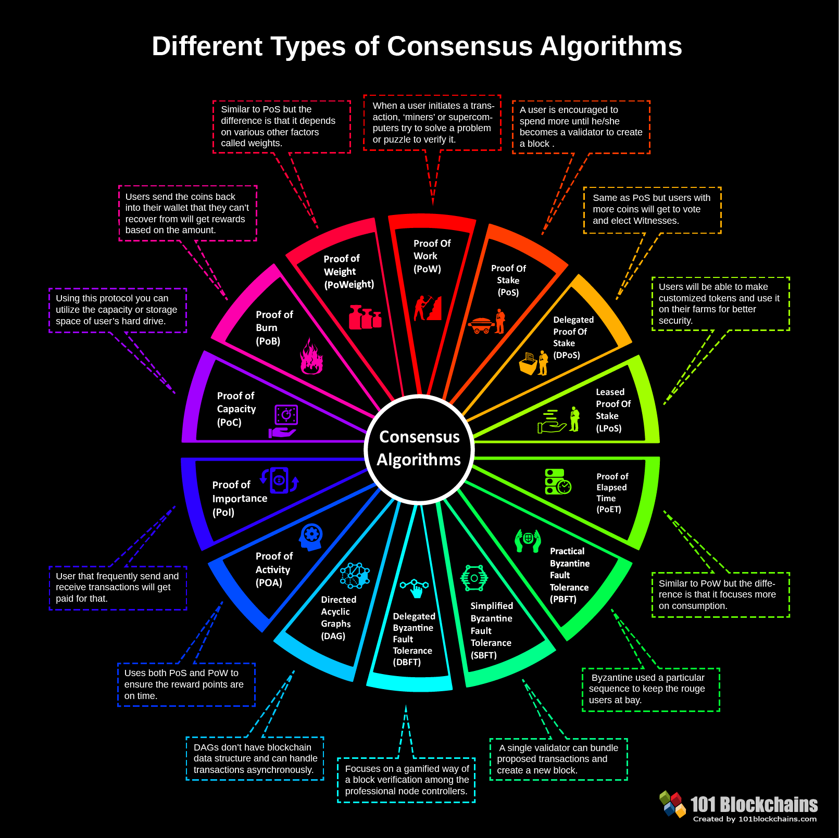
Different Consensus Algorithms

Slide 7
CFT Algorithms
Crash fault tolerant is a name given the algorithms that solve the problem of nodes crashing simply. So, we have a decentralized system where nodes can halt or disconnect from the network and yet we maintain the same state of truth on the system.
Paxos: CFT Algorithm
The most fundamental distributed consensus algorithm, allowing consensus over a value under unreliable communications.
Paxos is used to build a reliable system that works correctly, even in the presence of faults.
There are many other protocols that have since emerged from basic Paxos, such as Multi-Paxos, Fast Paxos, and Cheap Paxos.
Paxos works under an asynchronous network model and supports the handling of only benign failures, that is, it does not support Byzantine fault-tolerant protocol.
However, later, a variant of Paxos was developed that provides BFT.

Slide 8
Paxos: CFT Algorithm
Paxos makes use of 2f + 1 processes to ensure fault tolerance in a network where processes can crash fault, that is, experience benign failures.
Benign failure means either the loss of a message or a process stops.
Paxos can tolerate one crash failure in a three-node network.
Paxos is a two-phase protocol. The first phase is called the prepare phase, and the next phase is called the accept phase.
Paxos has a proposer and acceptors as participants, where the proposer is the replicas or nodes that propose the values, and acceptors are the nodes that accept the values.
The Paxos protocol assumes an asynchronous message-passing network with less than 50% of crash faults.
The critical properties of the Paxos consensus algorithm are safety and liveness.

Slide 9
Paxos: CFT Algorithm
Processes can assume different roles, which are listed as follows:
Proposers are elected leader(s) that can propose a new value to be decided.
Acceptors participate in the protocol as a means to provide a majority decision.
Learners are nodes that just observe the decision process and value.
A single process in a Paxos network can assume all three roles.
The key idea behind Paxos is that the proposer node proposes a value, which is considered final only if a majority of the acceptor nodes accept it. The learner nodes also learn this final decision.

Slide 10
Paxos: How does it work?
Paxos protocol works step by step as given below:
The proposer proposes a value by broadcasting a message, , to all acceptors.
Acceptors respond with an acknowledgment message if proposal n is the highest that the acceptor has responded to so far. The acknowledgment message consists of three variables, where n is the proposal number, v is the proposal value of the highest numbered proposal the acceptor has accepted so far, and s is the sequence number of the highest proposal accepted by the acceptor so far. This is where acceptors agree to commit the proposed value. The proposer now waits to receive acknowledgment messages from the majority of the acceptors indicating the chosen value.
If the majority is received, the proposer sends out the “accept” message to the acceptors.

Slide 11
Paxos: How does it work?
If the majority of the acceptors accept the proposed value (now the “accept” message), then it is decided: that is, an agreement is achieved.
Finally, in the learning phase, acceptors broadcast the “accepted” message to the proposer. This phase is necessary to disseminate which proposal has been finally accepted. The proposer then informs all other learners of the decided value. Alternatively, learners can learn the decided value via a message that contains the accepted value (decision value) multicast by acceptors.

Slide 12
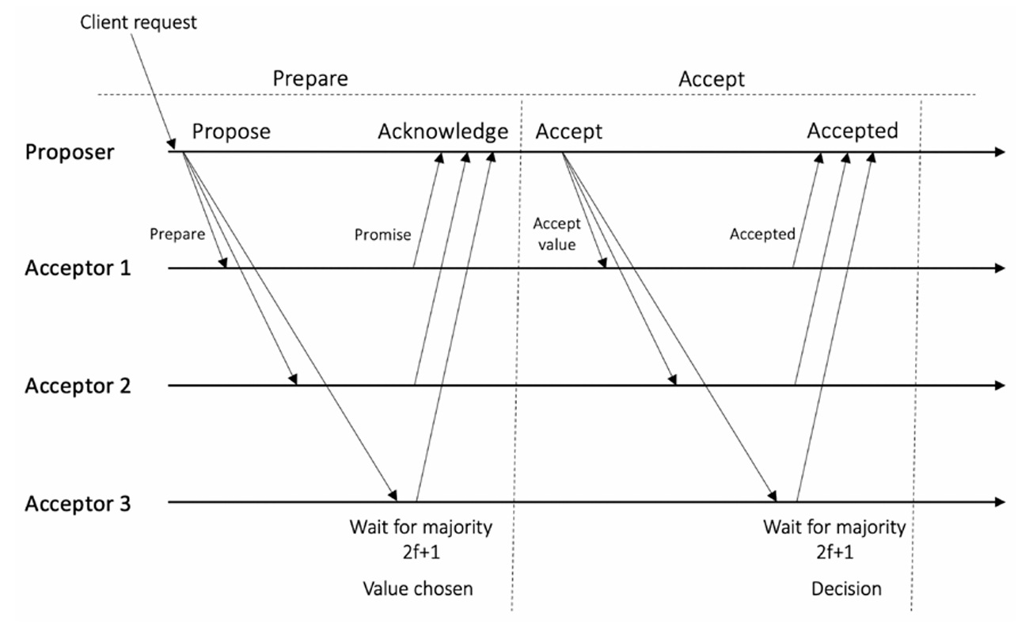
Paxos: How does it work?
Figure: How Paxos works

Slide 13
Paxos: How does it work?
Paxos is a consensus algorithm used in distributed systems to make all nodes agree on a single value, even when some nodes fail or messages get delayed.
There are three roles:
Proposers → propose a value.
Acceptors → decide which value gets chosen.
Learners → learn the final agreed value.
Step 1 — Proposal Phase (Prepare Request)
A proposer chooses a unique proposal number n and a proposed value v.
It sends a Prepare(n) message to all acceptors.

Slide 14
Paxos: How does it work?
Step 2 — Promise Phase (Acknowledgment)
When an acceptor receives Prepare(n), it checks if n is greater than any proposal number it has already responded to.
If yes, it promises:
  Not to accept any proposal < n in the future.
  Sends back a Promise message containing three variables:
    n → proposal number from proposer.
    v → value of the highest-numbered proposal the acceptor has already accepted (if any).
    s → sequence number of that highest proposal (often same as n).
At this point, no value is committed yet; acceptors only promise.

Slide 15
Paxos: How does it work?
Step 3 — Choosing the Proposal Value
After receiving promises from a majority of acceptors:
  If any acceptor has already accepted a value before, the proposer must choose the value v from the highest-numbered accepted proposal.
  If no acceptor has accepted anything, the proposer can use its own proposed value.
Step 4 — Accept Phase
The proposer now sends an AcceptRequest(n, v) message to all acceptors.
Each acceptor:
  Accepts (n, v) if it hasn’t promised a higher proposal number.
  Otherwise, it rejects the request.

Slide 16
Paxos: How does it work?
Step 5 — Decision Phase
If a majority of acceptors accept (n, v), then this value is chosen.
Step 6 — Learning Phase
Once a value is chosen, the acceptors:
  Send an Accepted(n, v) message to the proposer.
  The proposer then informs all learners of the final decided value.
  Alternatively, acceptors themselves can multicast the decision to learners.

Slide 17
Paxos: An illustrative Example
Setup
1 Proposer: P1
3 Acceptors: A1, A2, A3
Learners: L1, L2 (optional)
Proposer’s intended value: "X"
Step 1 — Propose
P1 selects proposal number n = 5 and value "X", sends:
Prepare(5)
to A1, A2, A3.
Step 2 — Promise
Each acceptor responds:

Slide 18
Paxos: An illustrative Example
Step 3 — Choose Proposal Value
Among all promises, the highest sequence number is from A3 (s=4, v="Z").
P1 must propose "Z" instead of its original "X" to maintain safety.
Step 4 — Accept Request
P1 sends:
AcceptRequest(5, v="Z")
to A1, A2, A3.
Acceptor | Previously Accepted Proposal | Promise Message
A1 | None | Promise(5, v=null, s=null)
A2 | Accepted (n=3, v="Y") | Promise(5, v="Y", s=3)
A3 | Accepted (n=4, v="Z") | Promise(5, v="Z", s=4)

Slide 19
Paxos: An illustrative Example
Step 5 — Accept
Acceptors accept (5, "Z") because they promised not to accept proposals < 5.
Step 6 — Learning
Once at least two acceptors (majority) accept "Z", the value is decided.
Acceptors send:
Accepted(5, "Z")
to P1.
P1 then notifies learners L1 and L2 that the final chosen value is "Z".

Slide 20
Paxos: Agreement, Validity and Liveness
Paxos ensures its safety and liveness guarantees. Paxos achieves all these properties efficiently.
Agreement is ensured by enforcing that only one proposal can win votes from a majority of the acceptors.
Validity is ensured by enforcing that only genuine proposals are decided. In other words, no value is committed unless it is proposed in the proposal message first.
Liveness, or termination, is guaranteed by ensuring that at some point during the protocol execution, eventually, there is a period during which there is only one fault-free proposer.

Slide 21
Replication in Distributed Systems
Replication is a standard approach to improve the fault tolerance and availability of a network. Replication results in a synchronized copy of data across all nodes in a network. This means that even if some of the nodes become faulty, the overall system/network remains available due to the data being available on multiple nodes.
There are two main types of replication techniques:
Active replication, which is a type where each replica becomes a copy of the original state machine replica.
Passive replication, which is a type where there is only a single copy of the state machine in the system kept by the primary node, and the rest of the nodes/replicas only maintain the state.

Slide 22
Active Replication in Distributed Systems
Active replication is a fault-tolerance approach in distributed systems where all replicas (servers) process client requests independently and simultaneously. All replicas maintain the same state and perform the same operations, ensuring consistency.
Example: Online Voting System
Consider an online voting system where users vote for candidates, and the results must remain consistent even if some servers fail.
Setup:
Replicas (Active Servers):
  Multiple servers (e.g., Server A, Server B, Server C) are running the same application.
  All servers receive and process the same client requests.

Slide 23
Active Replication in Distributed Systems
2. Request Distribution:
  A client’s vote (e.g., "Vote for Candidate X") is sent to all replicas.
  Each replica processes the vote independently and updates its local state.
3. Workflow:
A user submits a vote for Candidate X.
The request is broadcast to all replicas using a reliable multicast protocol (e.g., Paxos or Raft).
Each replica:
  Processes the request independently.
  Updates its local vote count for Candidate X.
After processing, the replicas maintain a consistent state (e.g., Candidate X has 100 votes across all servers).
If a client queries any replica for the current vote count, it receives the same result regardless of which server responds.

Slide 24
Active Replication in Distributed Systems
Fault Tolerance:
If one or more replicas fail, the system continues to operate using the remaining replicas.
New replicas can be added and synchronized with the existing state.
Advantages of Active Replication:
High Availability: No single point of failure, as all replicas are active and can respond to client requests.
Consistency: Consistent state is maintained across all replicas due to deterministic processing of identical requests.

Slide 25
Active Replication in Distributed Systems
Limitations:
Increased Overhead: Processing the same request on all replicas leads to redundant computation.
Synchronization Complexity: Requires precise ordering of requests (e.g., using consensus algorithms) to ensure all replicas process them in the same sequence.
Active replication is commonly used in mission-critical systems, such as flight control systems, financial transaction systems, and distributed databases, where availability and consistency are paramount.

Slide 26
Passive Replication in Distributed Systems
Passive replication, is a fault-tolerance technique in distributed systems where one server (the primary) handles all client requests and updates. The backups remain passive and synchronize their state with the primary to take over in case of failure.
Example: Bank Account Management System
Imagine a distributed banking system where clients can deposit or withdraw money from their accounts. To ensure fault tolerance, the system uses passive replication.

Slide 27
Passive Replication in Distributed Systems
Setup:
1. Primary Server (Active):
  Handles all client requests (e.g., deposit, withdrawal).
  Updates the account balance.
2. Backup Servers (Passive):
  Do not handle client requests directly.
  Receive state updates from the primary server.
  Synchronize periodically or after every transaction.

Slide 28
Passive Replication in Distributed Systems
3. Workflow:
A client sends a deposit request of $100 to the primary server.
The primary server processes the request:
  Updates the account balance (e.g., from $500 to $600).
  Sends the updated balance and transaction log to the backup servers.
Backup servers store the updated balance and log but do not process the request directly.
If the primary server fails:
  One of the backup servers is promoted to become the new primary.
  It continues processing client requests using the synchronized state.

Slide 29
Replication in Distributed Systems
This approach ensures:
Fault tolerance: The system can continue functioning even if the primary fails.
Consistency: Backups always maintain a consistent state with the primary.
Limitations:
Latency: Synchronizing backups can introduce delays.
Single point of failure during updates: If the primary fails before backups are updated, some data may be lost.
Passive replication is widely used in systems like databases, cloud services, and financial applications where strong consistency is crucial.

Slide 30
Timing assumptions in Consensus Algorithms Design
There are also some timing assumptions that are made when designing consensus algorithms:
Synchrony: There is a known upper bound on communication and processor delays. Synchronous algorithms are designed to be run on synchronous networks. In a synchronous system, a message sent by a processor to another is received by the receiver in the same communication round as it is sent.
Asynchrony: In asynchronous systems, there is no upper bound on communication and processor delays. Asynchronous algorithms are designed to run on asynchronous networks without any timing assumptions. These systems are characterized by the unpredictability of message transfer (communication) delays and processing delays.
Partial synchrony: There is an upper bound on the communication and processor delays, However, this upper bound is not known to the processors. An eventually synchronous system is a type of partial synchrony, which means that the system becomes synchronous after an instance of time.

Slide 31
Examples of Synchronous, Asynchronous and Partial
Synchronous Systems
Definition Recap: There is a known upper bound on communication and processing delays. Messages are guaranteed to be delivered within a fixed time.
Example:
Imagine a military communication network where all computers are connected via a dedicated high-speed satellite link. Engineers know that messages will never take more than 2 milliseconds to travel between nodes.
  If node A sends a message in round 1, node B is guaranteed to receive it in the same round.
  Algorithms like the synchronous version of Paxos or synchronous Byzantine agreement can run safely here.

Slide 32
Examples of Synchronous, Asynchronous and Partial
Asynchronous Systems
Definition Recap: There is no upper bound on message delivery or processing delays. Messages may arrive arbitrarily late, or not at all.
Example:
Consider the public internet. Packets between two nodes may take 10 ms, 1 second, or even get lost and retried. There is no guaranteed maximum delivery time.
  For example, in a peer-to-peer file-sharing network (like BitTorrent), you can’t predict when peers will send or receive chunks.
  Algorithms like Raft or Paxos (asynchronous variant) are designed to tolerate such unpredictable timing by relying on timeouts and retries.

Slide 33
Examples of Synchronous, Asynchronous and Partial
Partially Synchronous Systems
Definition Recap: There is an upper bound on message delivery, but nodes don’t know what it is. Eventually, after some unknown point in time, the system behaves synchronously.
Example:
A blockchain network (e.g., Bitcoin or Ethereum) is a good illustration.
  In practice, messages usually get delivered within seconds or minutes, but during network congestion or attacks, delays can be unpredictable.
  After the network stabilizes, it effectively behaves like a synchronous system. Consensus algorithms like Practical Byzantine Fault Tolerance (PBFT) and Tendermint are designed for this model.

Slide 34
BFT Algorithms
A Byzantine fault refers to a situation where components of the system (e.g., nodes, processes) can fail and provide conflicting or malicious information to other components. These faults are the most challenging because they involve arbitrary or malicious behavior rather than simple crashes or benign failures.
Practical Byzantine Fault Tolerance
Practical Byzantine Fault Tolerance (PBFT) is a protocol developed to provide consensus in the presence of Byzantine faults. This algorithm demonstrated for the first time that PBFT is possible.
Istanbul Byzantine Fault Tolerance
The Istanbul Byzantine Fault Tolerance (IBFT) algorithm is a specific implementation of the Byzantine Fault Tolerance (BFT) consensus mechanism. It is commonly used in blockchain systems, particularly in enterprise or private blockchain platforms like Ethereum-based Quorum and Polygon (formerly Matic Network).

Slide 35
Practical BFT Algorithms
PBFT comprises three subprotocols:
Normal operation subprotocol refers to a scheme that is executed when everything is running normally, and no errors are in the system.
View change is a subprotocol that runs when a faulty leader node is detected in the system.
Checkpointing is another subprotocol, which is used to discard old data from the system.
The protocol runs in rounds where, in each round, an elected leader or primary node handles the communication with the client. In each round, the protocol progresses through three phases or steps. These phases are pre-prepare, prepare, and commit.
In order to tolerate Byzantine faults, the minimum number of nodes required is n = 3f + 1, where n is the number of nodes and f is the number of faulty nodes. PBFT ensures BFT as long as the number of nodes in a system stays n >= 3f + 1.

Slide 36
Practical BFT Algorithms
Example: Normal Operation Subprotocol
What it is: Runs when the system is healthy and no faults are detected.
Illustrative Example:
Suppose a PBFT network has 4 nodes (n = 3f + 1 with f = 1):
  Nodes: A (leader), B, C, D.
  A client sends a request “Transfer 10 coins to Bob” to the leader (A).
  Pre-prepare phase: Leader A proposes the request to the group.
  Prepare phase: Each replica (B, C, D) verifies the request and broadcasts their “prepare” messages.
  Commit phase: Once a node has collected enough “prepare” messages (2f + 1 = 3 in this case), they send “commit.” When commits are confirmed, the request is executed.
  The client finally receives confirmation that the transfer is successful.
Everything works smoothly, no leader change needed.

Slide 37
Practical BFT Algorithms
Example: View Change Subprotocol
What it is: Used when the leader (primary) is faulty, slow, or malicious. The system switches to a new leader (called a view change).
Illustrative Example:
  Using the same 4-node system (A, B, C, D), let’s say A (the leader) is faulty.
  A ignores the client’s request or sends inconsistent pre-prepare messages to different nodes.
  Nodes B, C, and D detect that progress isn’t being made.
  They initiate a view change:
    Each replica informs others that they want a new leader.
    Leader role shifts from A → B.
  Once B becomes the new leader, the protocol resumes normal operation with B handling client requests.
This ensures liveness: the system continues making progress even if the leader is faulty.

Slide 38
Practical BFT Algorithms
Example: Checkpointing Subprotocol
What it is: Used to discard old, unnecessary state so the system doesn’t keep infinite logs.
Illustrative Example:
  Imagine the network processes 1000 client requests over time. Each node logs these operations to stay consistent.
  Storing all logs forever would be inefficient.
  At request #1000, all nodes agree on a checkpoint (a snapshot of the system’s state, e.g., account balances at that point).
  Once the checkpoint is agreed upon, earlier logs (say requests #1–900) can be safely discarded.
  If a new node joins or a recovery is needed, the system can just replay from the checkpoint instead of the entire history.
This keeps storage efficient and helps recovery.

Slide 39
Practical BFT Algorithms: The Three Phases Within a Round
Each round in normal operation has pre-prepare → prepare → commit:
Pre-prepare phase
  Example: Leader A receives request from client: “Transfer 10 coins to Bob.”
  A broadcasts a pre-prepare message with this request to B, C, D.
Prepare phase
  B, C, D check if the request is valid.
  Each sends a prepare message to all other nodes saying “I agree this request is valid.”
  Now, nodes collect votes.
Commit phase
  Once a node receives 2f + 1 = 3 matching prepare messages, it broadcasts a commit message.
  When 2f + 1 commits are seen, the request is finalized.
  Client receives confirmation: “Transaction complete.”
This ensures both safety (no two nodes commit conflicting results) and liveness (progress is made as long as ≤ f faulty nodes).

Slide 40
Practical BFT Algorithms: The Three Phases Within a Round
Fault Tolerance Requirement: n = 3f + 1
What it means: To tolerate f faulty nodes, the system must have at least 3f + 1 total nodes.
Example:
  If the system wants to tolerate 1 faulty node (f = 1) → needs at least 4 nodes.
  If it wants to tolerate 2 faulty nodes (f = 2) → needs at least 7 nodes.
  With 7 nodes, even if 2 are malicious, the remaining 5 can still agree because the protocol requires 2f + 1 = 5 votes to commit safely.

Slide 41
Practical BFT Algorithms
Pre-prepare:
The main purpose of this phase is to assign a unique sequence number to the request. This is the first phase in the protocol, where the primary node receives (accepts) a request from the client. The primary node assigns a sequence number to the request. It then sends the pre-prepare message with the request to all backup replicas.
When the pre-prepare message is received by the backup replicas, it checks a number of things to ensure the validity of the message:
First, whether the digital signature is valid.
After this, whether the current view number is valid.
Then, whether the sequence number of the operation’s request message is valid.
Finally, whether the digest / hash of the operation’s request message is valid.
If all of these elements are valid, then the backup replica accepts the message. After accepting the message, it updates its local state and progresses toward the prepare phase.

Slide 42
Practical BFT Algorithms
Prepare:
This phase ensures that honest replicas/nodes in the network agree on the total order of requests within a view.
The pre-prepare and prepare phases together provide the total order to the messages.
A prepare message is sent by each backup to all other replicas in the system.
Each backup waits for at least 2f+1 prepare messages to be received from other replicas. They also check whether the prepare message contains the same view number, sequence number, and message digest values.
If all these checks pass, then the replica updates its local state and progresses toward the commit phase.

Slide 43
Practical BFT Algorithms
Commit:
This phase ensures that honest replicas/nodes in the network agree on the total order of requests across views.
In this phase, each replica sends a commit message to all other replicas in the network and wait for 2f+1 commit messages to arrive from other replicas.
The replicas also check the view number, sequence number, and message digest values. If they are valid for 2f+1 commit messages received from other replicas, then the replica executes the request, produces a result, and finally, updates its state to reflect a commit.
If there are already some messages queued up, the replica will execute those requests first before processing the latest sequence numbers.
Finally, the replica sends the result to the client in a reply message. The client accepts the result only after receiving 2f+1 reply messages containing the same result.

Slide 44
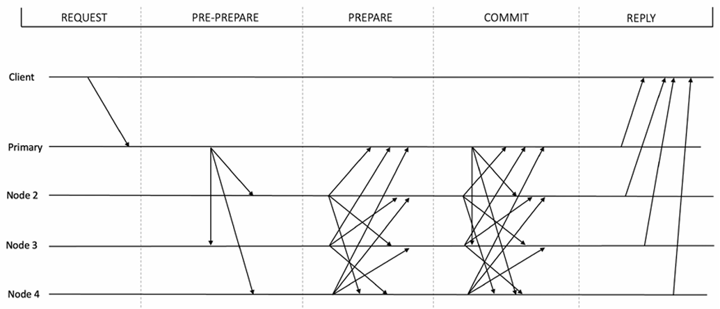
Visualization of Practical BFT Algorithms
Figure: Practical BFT protocol

Slide 45
Nakamoto Consensus
Nakamoto consensus is also known as Proof of Work(PoW).
It was first introduced with Bitcoin in 2009.
It has stood the test of time and is the longest-running blockchain network.
The PoW mechanism is not a consensus algorithm but a Sybil attack defense mechanism.
The consensus is actually achieved by applying the fork choice rule to choose the longest/heaviest chain to finalize the canonical chain.
We can say that PoW is a consensus facilitation algorithm that facilitates consensus and mitigates Sybil attacks, thus maintaining the blockchain’s consistency and network’s security.

Slide 46
Nakamoto Consensus
What is Sybil attack?
A Sybil attack is a type of attack that aims to gain a majority influence on the network to control the network. Once a network is under the control of an adversary, any malicious activity could occur. A Sybil attack is usually conducted by a node generating and using multiple identities on the network. If there are enough multiple identities held by an entity, then that entity can influence the network by skewing majority-based network decisions. The majority in this case is held by the adversary.
Background of PoW:
The key idea behind PoW as a solution to the Byzantine generals problem is that all honest generals (miners in the Bitcoin world) achieve agreement on the same state (decision value). As long as honest participants control the majority of the network, PoW solves the Byzantine generals problem. Note that this is a probabilistic solution and not deterministic.

Slide 47
Nakamoto Consensus
Examples: Sybil Attack
Online Voting System
Imagine an online community where members vote on proposals (like approving a new feature).
Each member gets one vote, and decisions are made by majority.
An attacker creates 100 fake accounts (Sybil identities).
When a proposal comes up, the attacker uses these accounts to cast 100 extra votes.
Even though the honest community has only 30 real members, the attacker’s Sybil accounts outvote them.
Result: the attacker can push malicious or self-serving decisions.

Slide 48
Nakamoto Consensus
Examples: Sybil Attack
Peer-to-Peer Network (File Sharing)
Suppose you are in a P2P file-sharing system (like BitTorrent).
Normally, peers share pieces of a file with each other.
An attacker floods the network with many fake peers (Sybil nodes) all pretending to host the file.
Honest nodes try to connect to what looks like many different peers, but in reality, they all belong to the attacker.
The attacker can then:
  Refuse to share file pieces (denial of service).
  Send corrupted file pieces (poisoning).
  Track or deanonymize other users.

Slide 49
Nakamoto Consensus
Examples: Sybil Attack
Blockchain Network
In a blockchain consensus system (like Bitcoin or Ethereum), nodes vote on which block to accept.
An attacker creates thousands of fake nodes and connects them to the network.
If the network were naive and counted nodes equally (without proof-of-work/stake), the attacker’s fake nodes could outvote honest nodes.
This could let them double-spend coins, censor transactions, or take over the ledger.
(That’s why real blockchains use proof-of-work or proof-of-stake to make Sybil attacks costly.)

Slide 50
Nakamoto Consensus
How PoW works?
PoW makes use of hash puzzles.
A node that proposes a block has to find a nonce such that H (nonce || previous hash || Tx || … || Tx) < Threshold value. This threshold value or the target value is based on the mining difficulty of the network, which is set by adding or reducing the number of zeroes in front of the target hash value. More zeroes mean more difficulty and a smaller number of zeroes means less difficult to solve. If there are more miners in the network, then the mining difficulty increases, otherwise, it reduces as the number of miners reduces.
The process can be summarized as follows:
New transactions are broadcast to the network.
Each node collects the transactions into a candidate block.
Miners propose new blocks.

Slide 51
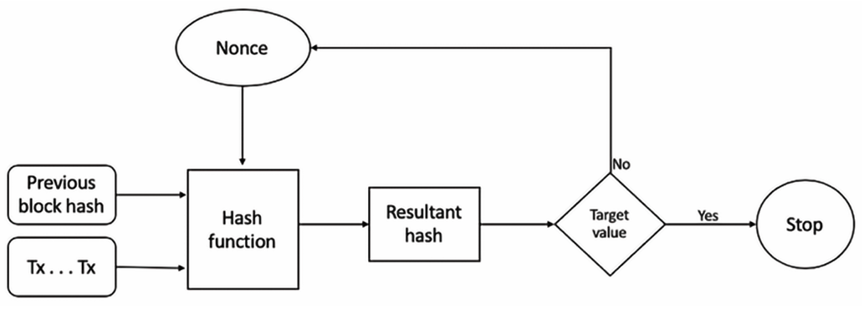
Consensus Algorithms
How PoW works?
Miners concatenate and hash with the header of the previous block.
The resultant hash is checked against the target value, that is, the network difficulty target value.
If the resultant hash is less than the threshold value (the target value), then PoW is solved, otherwise, the nonce is incremented and the node tries again. This process continues until a resultant hash is found that is less than the threshold value.
Figure: How PoW works.

Slide 52
Nakamoto Consensus
How Nakamoto Consensus meets the traditional consensus?
The Nakamoto consensus was the first of its kind. It solved the consensus problem, which had been traditionally solved using pre-Bitcoin protocols like PBFT. However, we can map the properties of PoW consensus to traditional Byzantine consensus.
In traditional consensus algorithms, we have agreement, validity, and liveness properties, which can be mapped to Nakamoto-specific properties of the common prefix, chain quality, and chain growth properties respectively:
The common prefix property means that the blockchain hosted by honest nodes will share the same large common prefix. If that is not the case, then the agreement property of the protocol cannot be guaranteed, meaning that the processors will not be able to decide and agree on the same value.
The chain quality property means that the blockchain contains a certain required level of correct blocks created by honest nodes (miners). If chain quality is compromised, then the validity property of the protocol cannot be guaranteed. This means that there is a possibility that a value will be decided that is not proposed by a correct process, resulting in safety violations.
The chain growth property simply means that new correct blocks are continuously added to the blockchain. If chain growth is impacted, then the liveness property of the protocol cannot be guaranteed. This means that the system can deadlock or fail to decide on a value.

